Slide 1
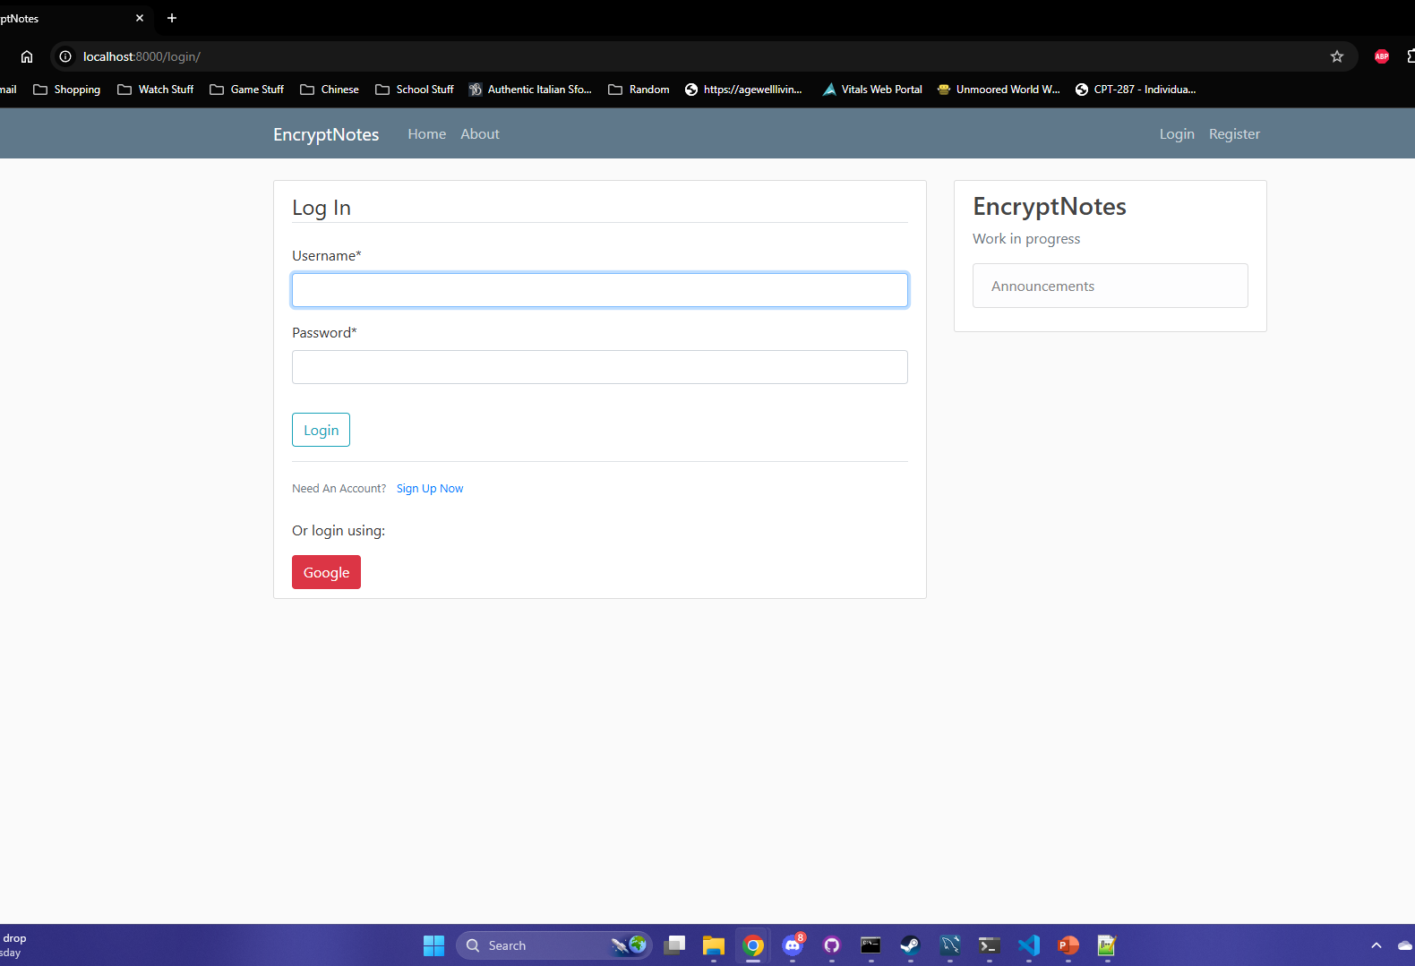
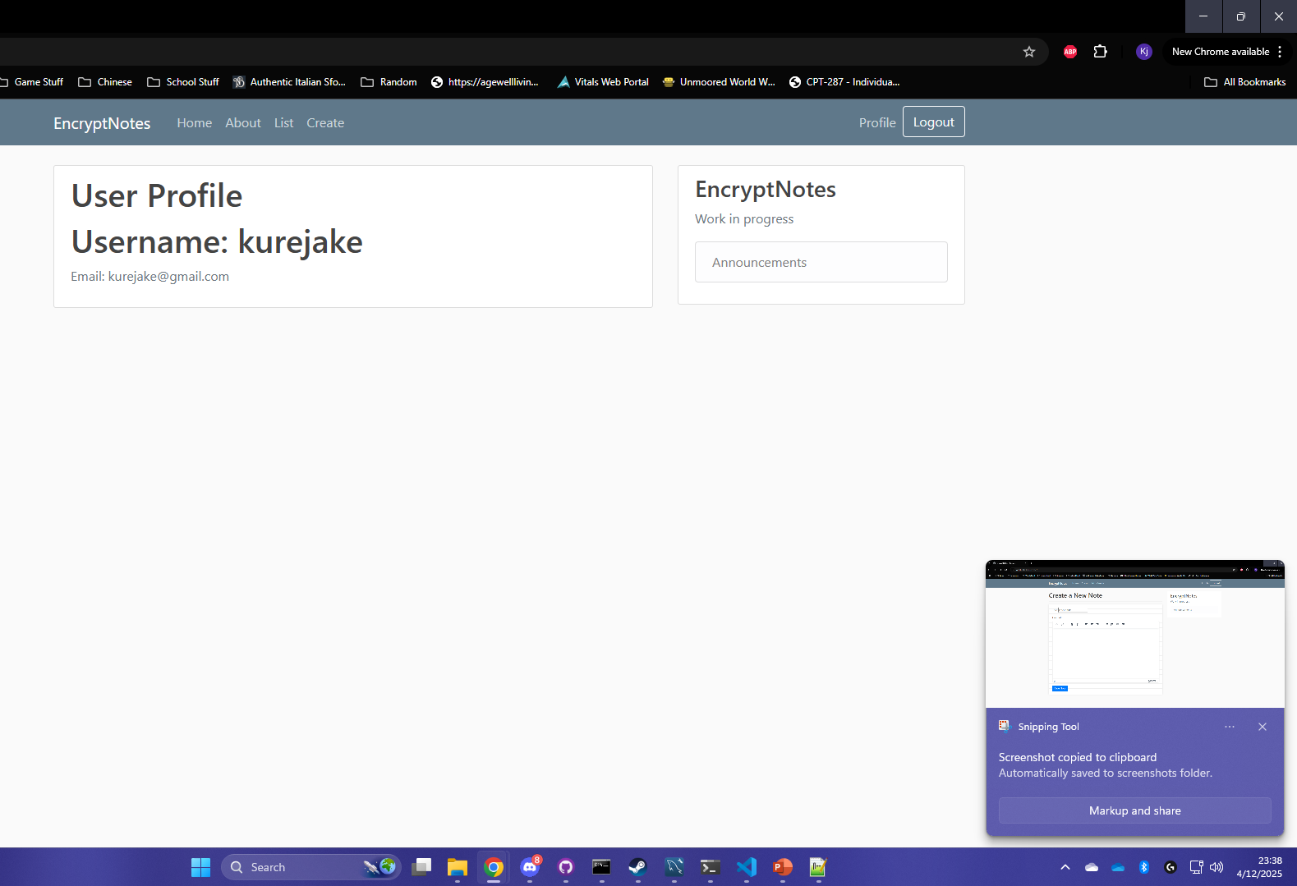
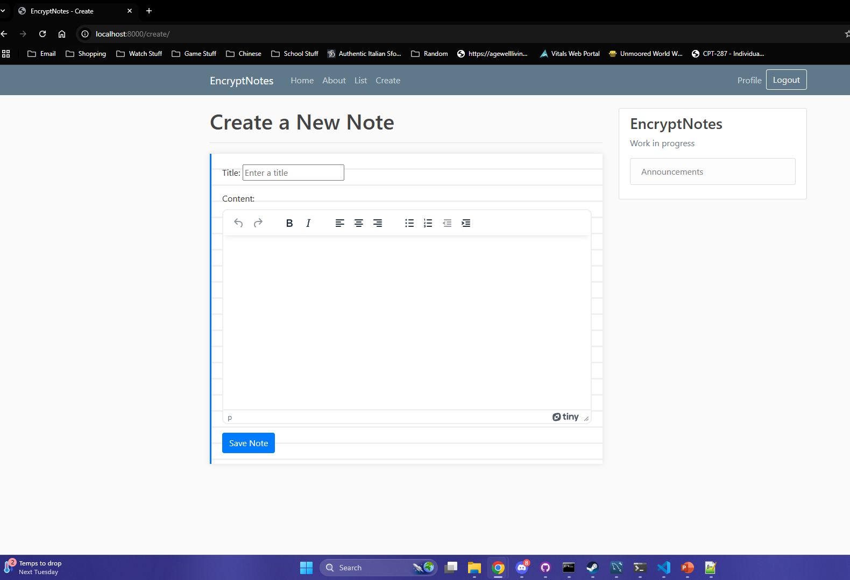
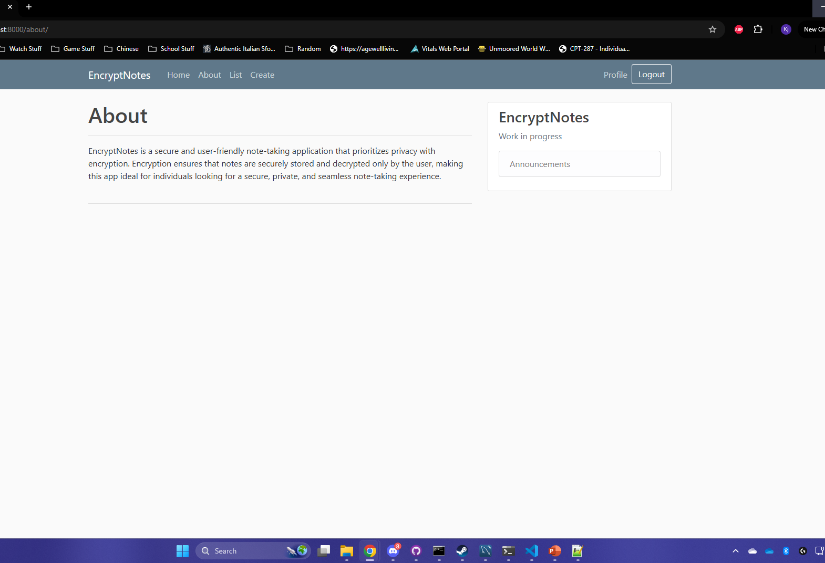
EncryptNotes
Phase 3
Team 2
Duncan, Kurejake, Jacob, Grant, Kaden

Slide 2
Log in page
This page is the first thing you see when opening EncryptNotes.
Users can sign up and login.

Slide 3
Profile page

Slide 4
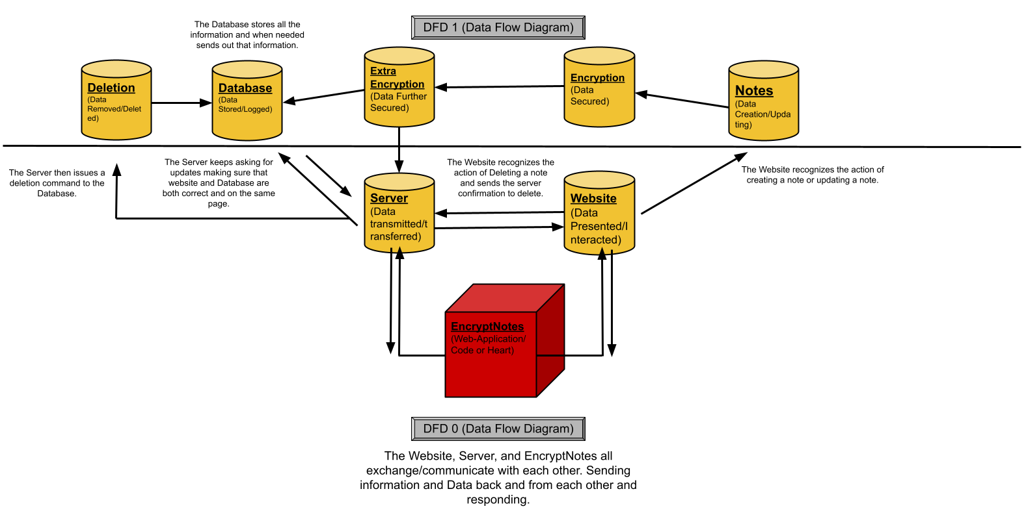
Data Flow
This show two levels of the data flow or structure in the EncryptNotes
The first layer is the main one, where the core components share and send information
Sending commands or updates to each other
Then the second layer is a further look a how the data flows, from server to database and website to notes

Slide 5
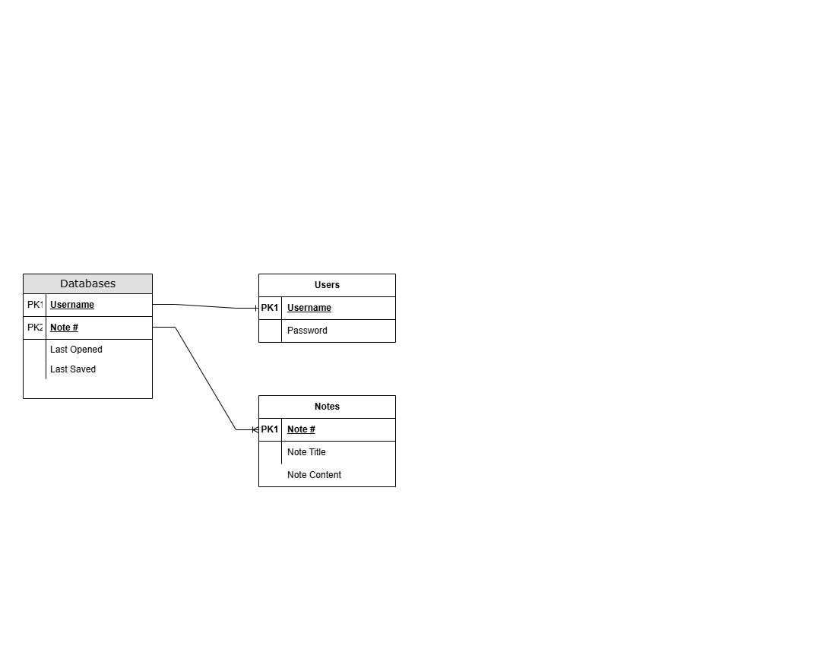
Entity Relationships
Place Holder (Hopefully)
Our Database contains information of Users and Notes
In the Database sections or tables are divide up into two
Firstly, One for User information like Username, Password, Email, Etc.
Secondly, one for Notes information like Note # (first, second and so forth), Note Content, Note Title, Etc.

Slide 6
Encryption Method
Notes are encrypted in the front-end every time the note is saved
Encryption Key is saved to the database to encrypt notes being queried by the front-end

Slide 7
Demonstration
Now onto a Demonstration…
That’s if we could easily but not so.
So, we’ll describe what “would” happen.
We would start by starting up / going to the site and login in or signing up
Then from there showing the multiple pages and then final go to the NOTE page
Where we show how the note would work, like creating a new note, editing, saving, and deletion.

Slide 8
Questions?

